Slide 1
Intro to DevOps & Docker
BugSmashers 3/21 Hack Night!
Notes:
dk8

Slide 2
What makes up Dev Ops?
Philosophy
Practices
Tools
Why devops? what is the utility?
Practices that define devops
Dev Ops Lifecycle
implementing devops practices and philosophy
Dev Ops
Notes:
dk8

Slide 3
Developer Operations?????????????
01
03
Developers
SLOW
These are the people who write a software to deliver for a customer.
Separating these two teams introduces many problems.
02
04
Operations
Dev Ops!
These are the people who maintain, and improve the software after release.
Developers and Operators work together!
Youtube Explanation
Notes:
d3

Slide 4
Why Dev Ops
Development Efficiency
Adapt, improve, and deliver code faster!
Reliability
Code is better tested and more responsive to customer needs!
Scalability
Adaptation and improvement of software is much easier!
Collaboration
Collaboration between developers, operators, and customers is better!
Notes:
dk8

Slide 5
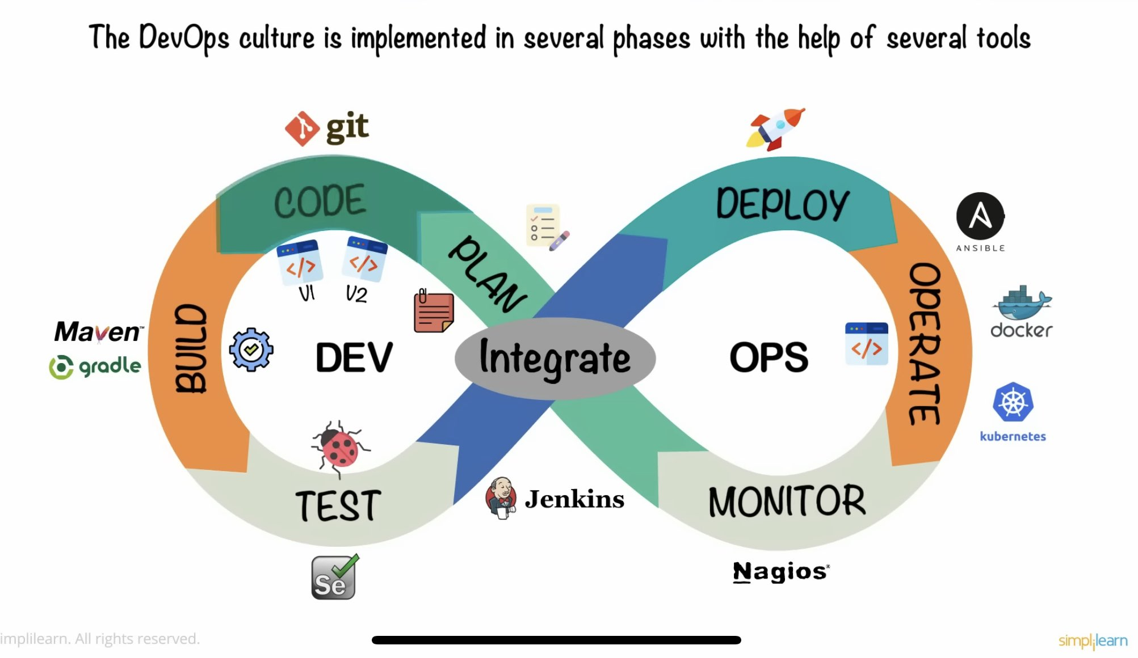
The DevOps Lifecycle
Notes:
dk8

Slide 6
The DevOps Lifecycle - Explained
1
8
Planning
Integrate / Plan
Dev team creates plan
Send code back to Dev Team
2
7
Code
Monitor
Dev teams work on code
Watch for bugs
3
4
5
6
Build
Test
Deploy
Operate
Make code executable
Testing code automatically
Send code to ops team
Ops team deploys code to users
Notes:
https://www.browserstack.com/guide/devops-lifecycle
https://webcache.googleusercontent.com/search?q=cache:https://medium.com/taptuit/the-eight-phases-of-a-devops-pipeline-fda53ec9bba

Slide 7
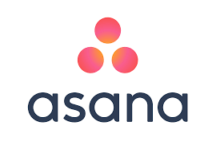


Planning
Everything that happens before developers start writing code.
Think of a project - what happens here?
Determine Requirements
Document Requirements
Figure out Libraries
Organize a Team
Agile Development - Sprints
Customer Stories - Use Cases
Ticket Management
Notes:
d3

Slide 8
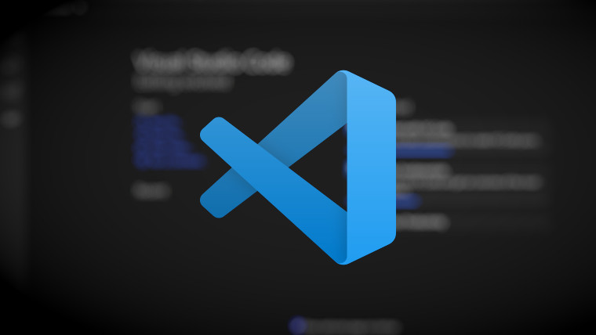
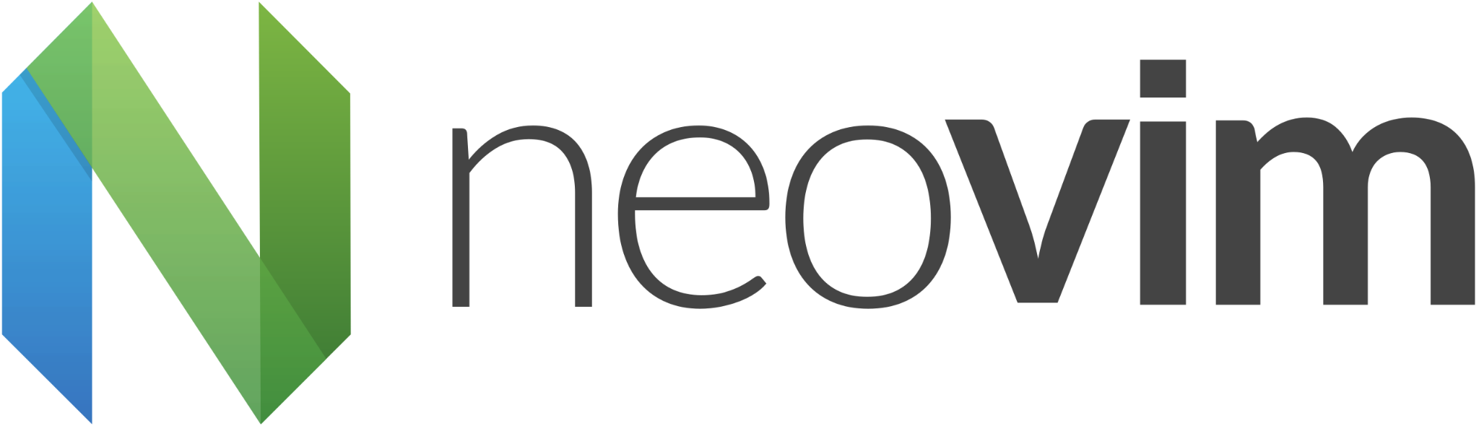
Code
This is the step we’re most familiar with, so we won’t cover much here.
Notes:
d3

Slide 9
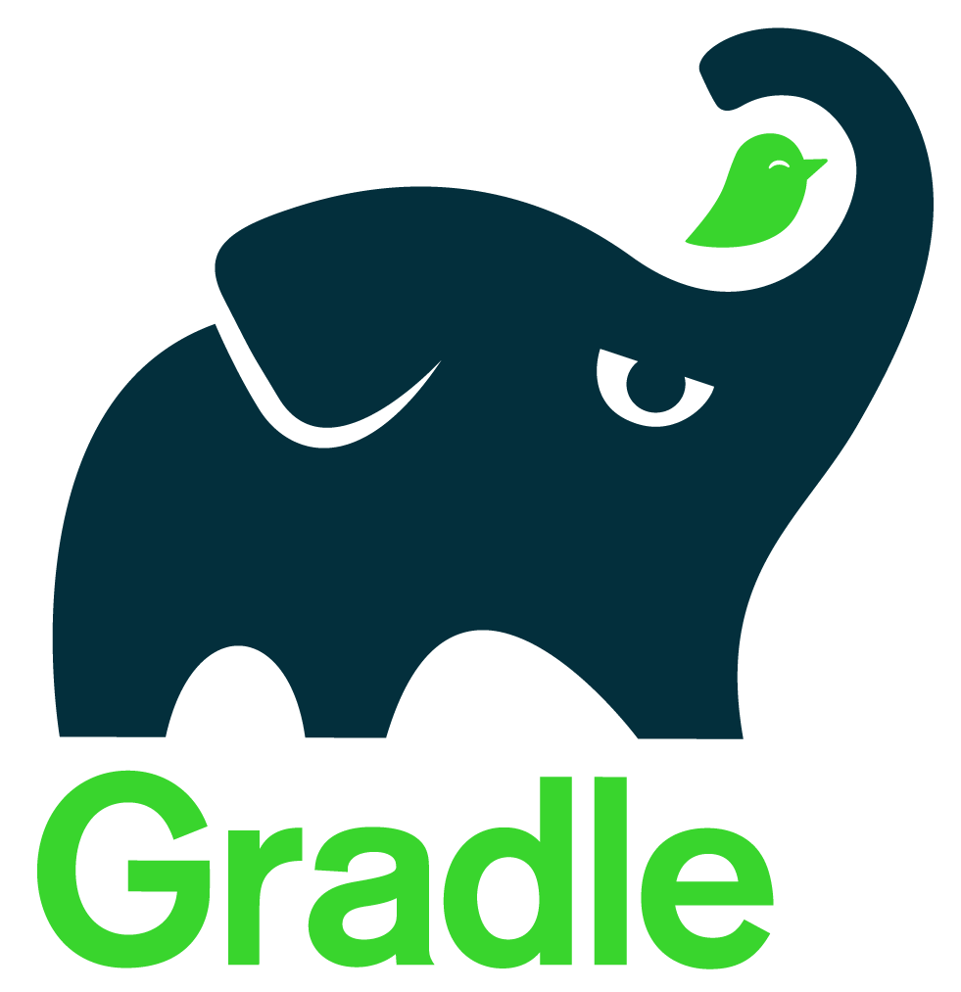
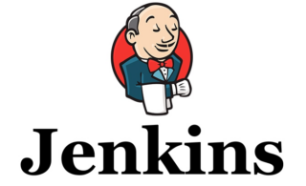

Build & Test
This is where DevOps starts!
Build Step - Turning Source Code > Executables
Pull Request - First Step of the build process
A dev has finished their code, and wants to submit it!
Other devs double-check their code for any obvious mistakes
Simultaneously, automatic (unit) tests are performed on the developer’s code
Testing Process - More rigorous Testing
Usually deployed to a different environment - mimics user interaction & system
Security Testing
Any other compliance testing - Industry Specific
Notes:
d3
Travis CI is the cloud solution to use when it comes to automating the build & testing of GitHub repositories. Since Travis is cloud-based, it is easy to use with a user-friendly GUI.
The open-source build automation tool Gradle places a premium on adaptability and speed. It defines build scripts with a Groovy-based DSL (Domain-Specific Language).
Jenkins is a widely used open-source automation server that makes CI/CD procedures easier. It allows programmers to rapidly and reliably create, test, & release software. It works with multiple programming languages and can run on various platforms (Windows, Linux, and macOS).

Slide 10
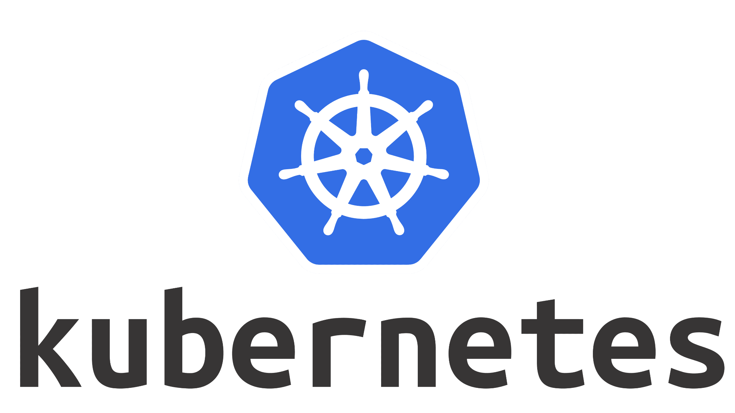
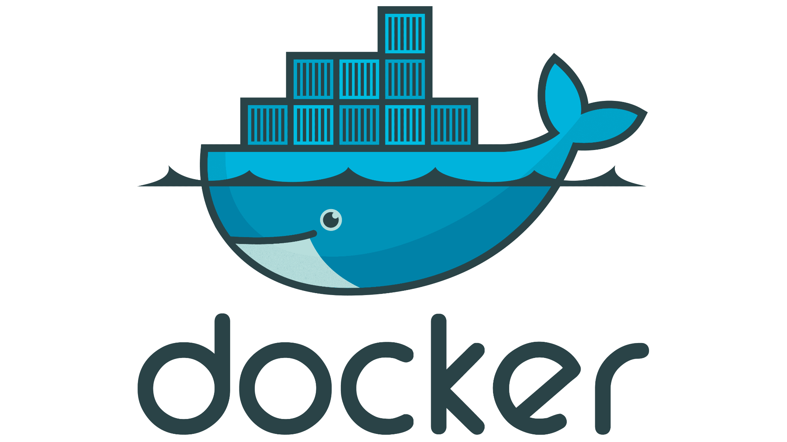
Deploy, Operate & Monitor
Deploy
Deploy software to servers in a way that is scalable, secure, and efficient
Docker Containers, Kubernetes make this easier
Automatically deploy software that is ready for production
Operate & Monitor
After deployment, teams use specific tools to watch for bugs, monitor performance, and improve software when needed
This is CI/CD - we have tools to continuously implement and deliver changes to software as it is running, eliminating downtime
As you might imagine, software tools are really crucial here!
Automatic bug monitoring and reporting, customer behavior/feedback analysis, scaling software, etc.
Notes:
d3

Slide 11
Continuous Integration / Continuous Delivery (CI/CD)
Continuous Integration
Continuous Delivery
Integrating code into main branch often, with automated tests and builds. Minimizes conflicts!
Packages CI content for deployment so that it can be run in any environment.
Notes:
dk8

Slide 12
These Create CI/CD Pipelines!
A CI/CD pipeline is an automated process utilized by software development teams to streamline the creation, testing and deployment of applications.
Common IDEs, VSCode, NVim, etc.
Selenium, Unit Tests
Kubernetes, Ansible - reduce necessary downtime
We Automatically have production-ready code!
Develop Code
Auto-test Code
Auto-update Software
Commit Code
Auto-deploy Code
Auto-Report Bugs
Version Control Systems - Git, Gitlab, etc.
Docker, AWS deploys code to servers
bug reporting, poor performance, user behavior reporting
Notes:
d3

Slide 13
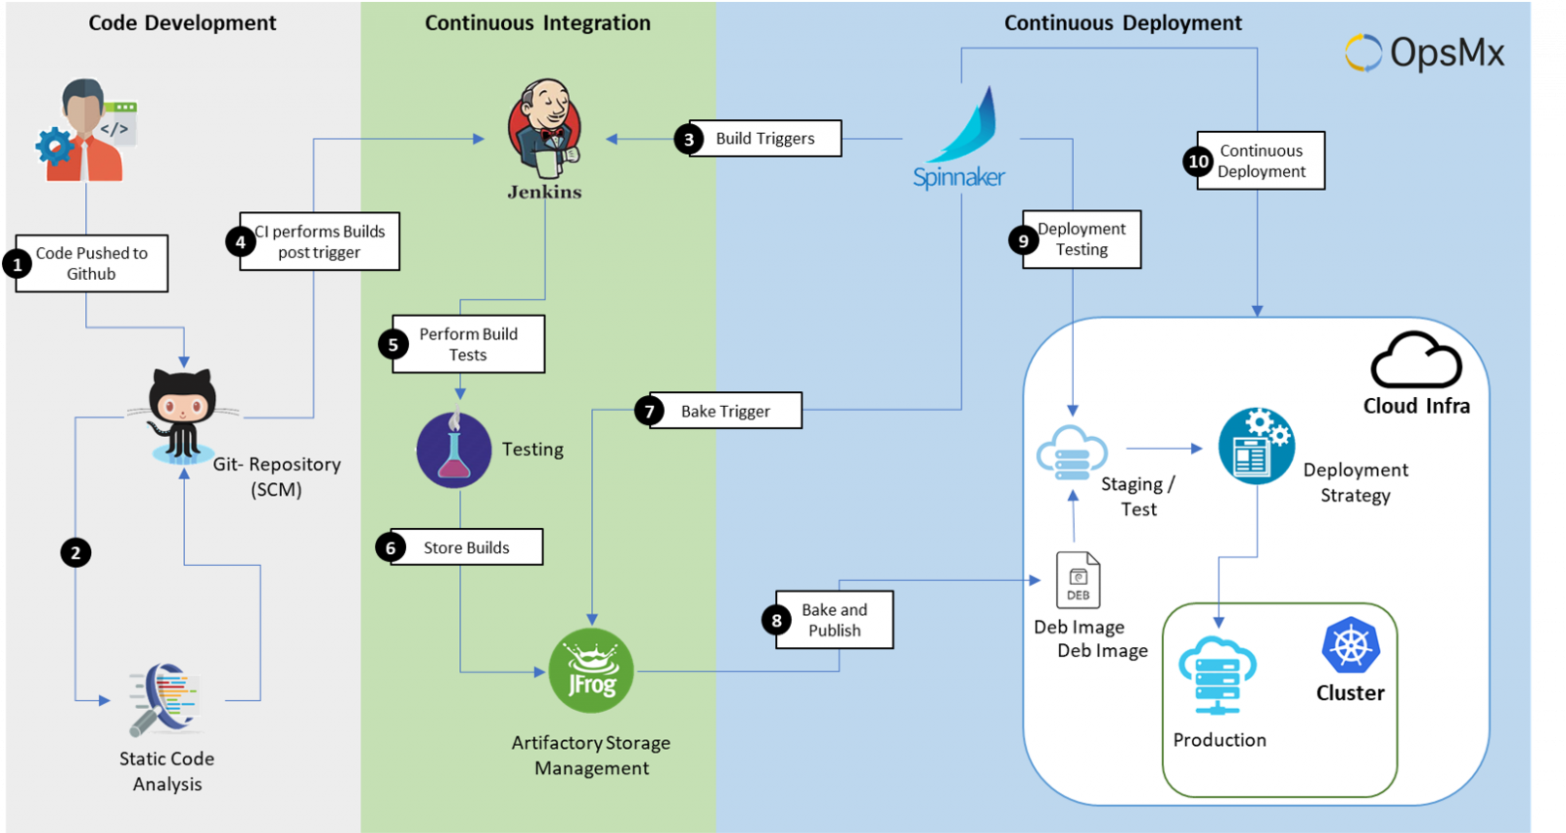
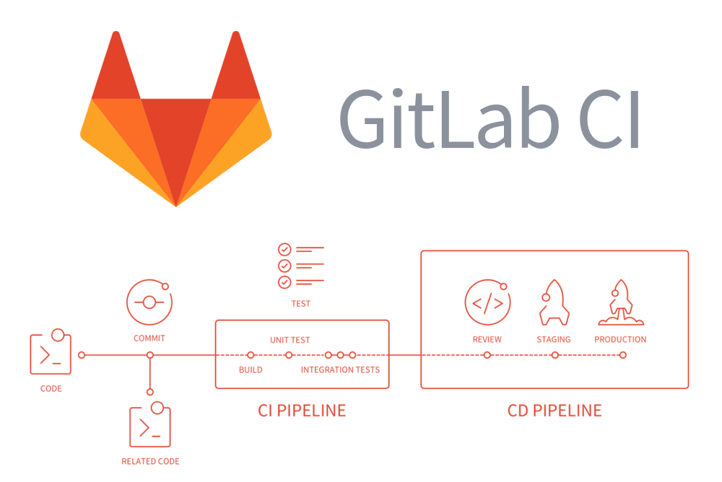
CI/CD Pipelines
Notes:
d3

Slide 14

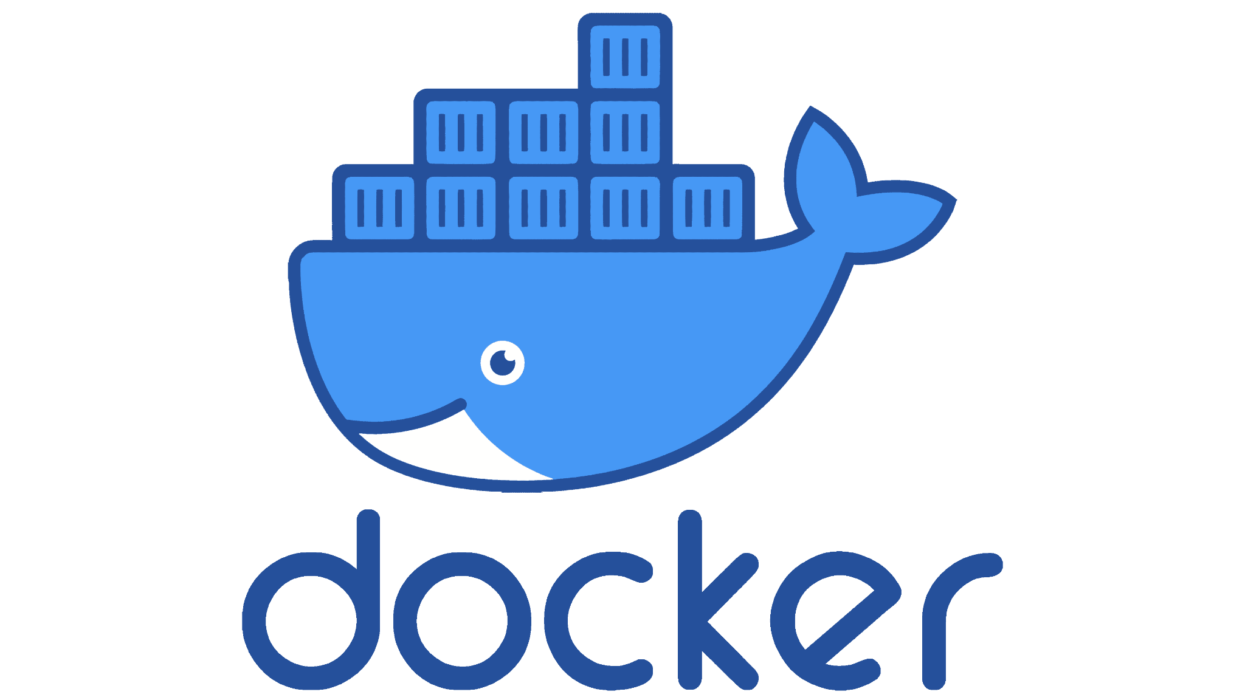
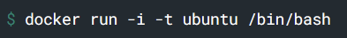
Containers
Swarm
Runnable instance of an image
Treats group of Docker hosts as single host
Images
Compose
Read-only template with container construction instructions
Config tool to run multiple containers at once
Volume
Simplifies CI/CD
Docker’s form of persistent storage
(and it’s coded in Go!)
Notes:
dk8
The following command runs an ubuntu container, attaches interactively to your local command-line session, and runs /bin/bash.
Mention its usage in build, test, & deploy.
https://github.com/egonelbre/gophers

Slide 15
Resc
https://labs.iximiuz.com/playgrounds
https://aws.amazon.com/devops/what-is-devops/
https://www.browserstack.com/guide/build-tools
https://www.browserstack.com/guide/top-devops-monitoring-tools
https://staragile.com/blog/docker-in-devops#:~:text=Docker%27s%20container-based%20platform%20is,then%20deployed%20to%20any%20infrastructure.
https://about.gitlab.com/topics/ci-cd/
https://aws.amazon.com/devops/what-is-devops/
https://www.simform.com/blog/devops-lifecycle/
https://www.atlassian.com/devops/devops-tools/devops-monitoring
https://docs.docker.com/get-started/overview/

